Slide 1


Adders Mania
All of the Slides contain Audio (we explain the project on these audio records)
Cairo University Faculty of Engineering Computer Engineering Department CMP3020

Slide 2
Team
Name | Sec | B.N. | Code
Abdelrahman Mohamed Abdelfattah | 1 | 22 | 9210587
Osama Saleh Farag | 1 | 12 | 9210195
Amr Salahuddin Fouad | 1 | 29 | 9210774
Abdelrahman Mohamed Hefney | 1 | 21 | 9210584

Slide 3
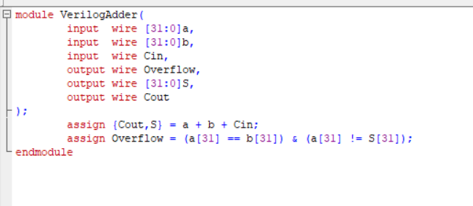
Verilog Adder
Code

Slide 4
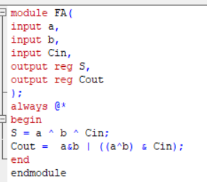
Ripple Carry Adder
It uses Smaller Module Traditional Full adder (FA)
It’s Code:

Slide 5
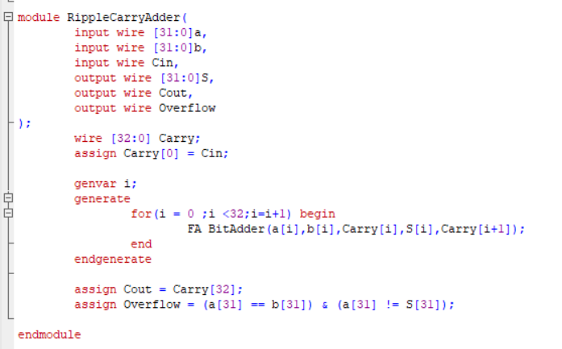
Ripple Carry Adder
Ripple Carry Code:

Slide 6
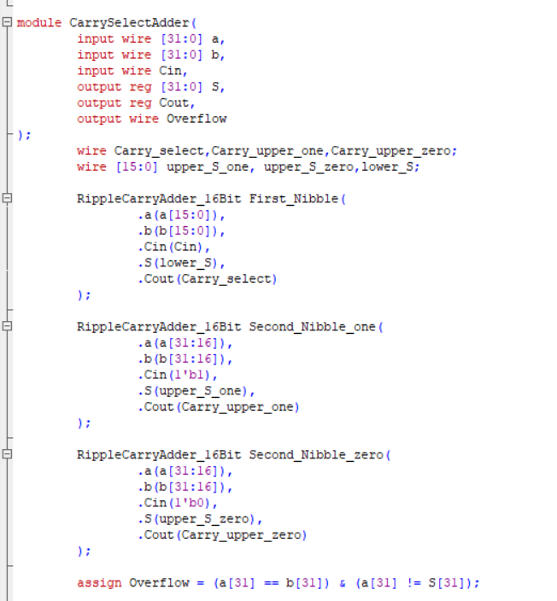
Carry Select Adder
It uses 3 Ripple Carry adders of 16-bits, The first 16-bits carry output selects the correct output from the second 16 Ripple carry Adder.
Carry Select Code:
Instantiation of Modules

Slide 7
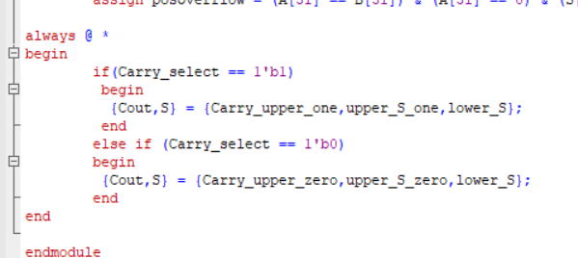
Carry Select Adder
Output Selection:

Slide 8
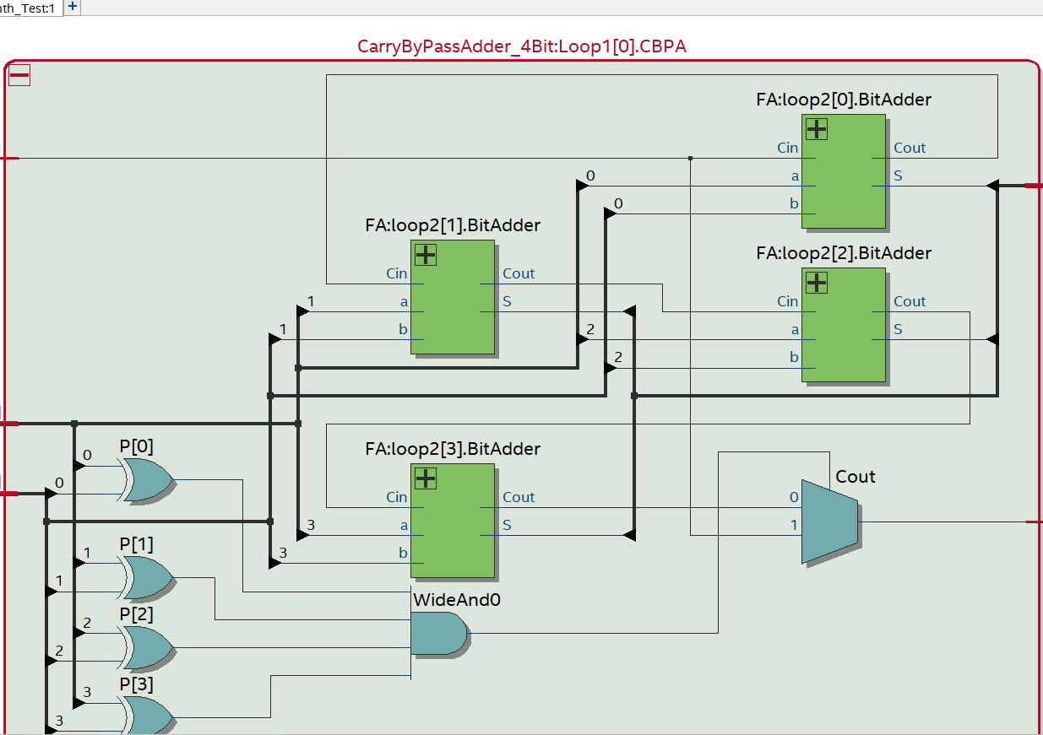
Carry Bypass
It Enhances Ripple carry Adder, as it sees if the carry propagate is 1 in every bit, the carry out will be the carry in.
We divided the 32-bits adder into 8 4-bit adders, each block has the architecture found in this schematic

Slide 9
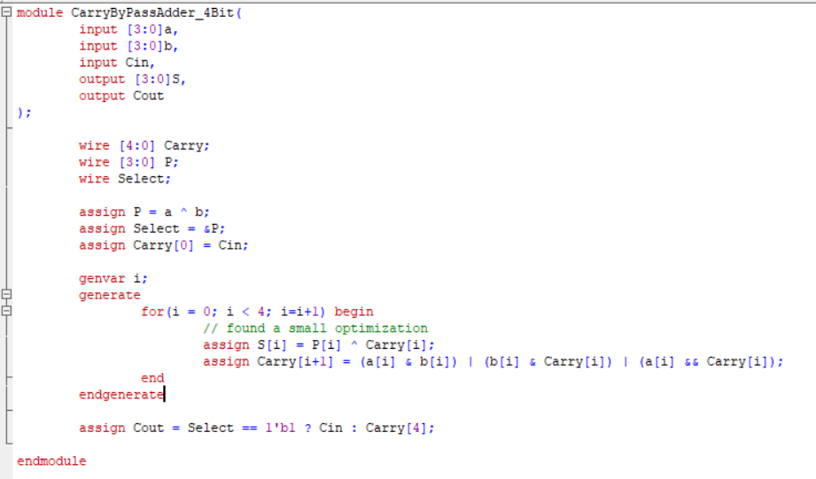
Carry Bypass
4-bit Carry Bypass Code:

Slide 10
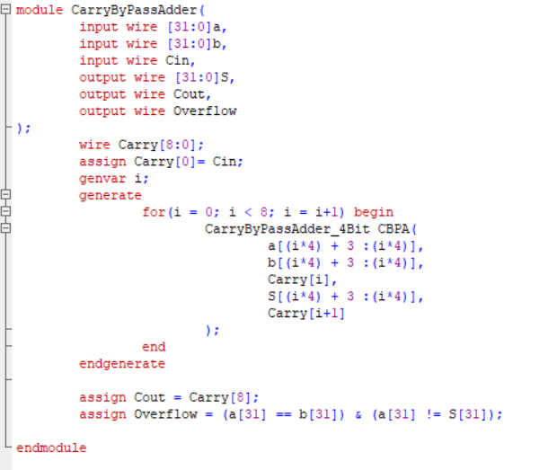
Carry Bypass
Carry Bypass 32-bit Code:

Slide 11
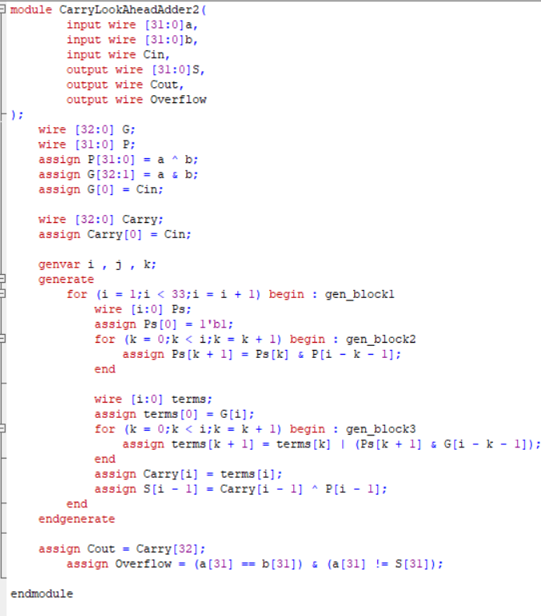
Carry Lookahead
Code:
Notes:
module CarryLookAheadAdder2(
input wire [31:0]a,
input wire [31:0]b,
input wire Cin,
output wire [31:0]S,
output wire Cout,
output wire Overflow
);
wire [32:0] G;
wire [31:0] P;
assign P[31:0] = a ^ b;
assign G[32:1] = a & b;
assign G[0] = Cin;
wire [32:0] Carry;
assign Carry[0] = Cin;
genvar i , j , k;
generate
for (i = 1;i < 33;i = i + 1) begin : gen_block1
wire [i:0] Ps;
assign Ps[0] = 1'b1;
for (k = 0;k < i;k = k + 1) begin : gen_block2
assign Ps[k + 1] = Ps[k] & P[i - k - 1];
end
wire [i:0] terms;
assign terms[0] = G[i];
for (k = 0;k < i;k = k + 1) begin : gen_block3
assign terms[k + 1] = terms[k] | (Ps[k + 1] & G[i - k - 1]);
end
assign Carry[i] = terms[i];
assign S[i - 1] = Carry[i - 1] ^ P[i - 1];
end
endgenerate
assign Cout = Carry[32];
assign Overflow = (a[31] == b[31]) & (a[31] != S[31]);
endmodule

Slide 12
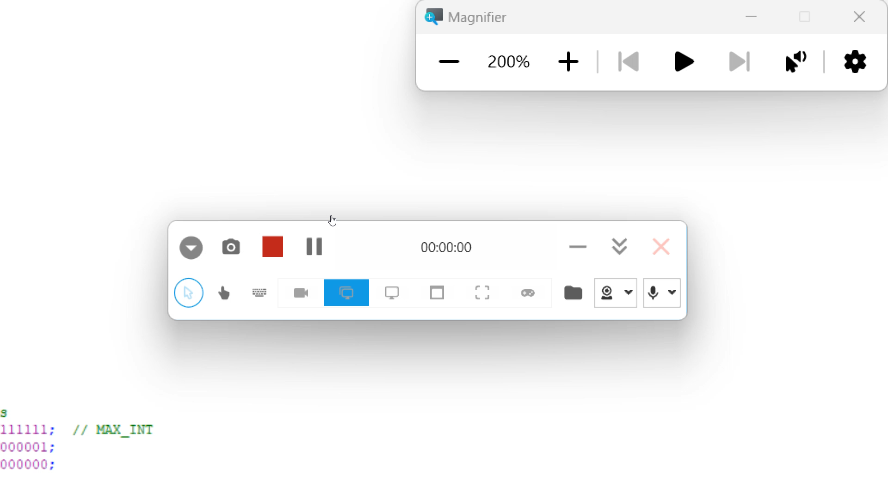
Test Bench
Code:

Slide 13
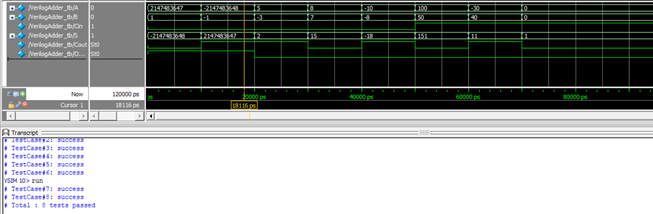
Results
Verilog Adder

Slide 14
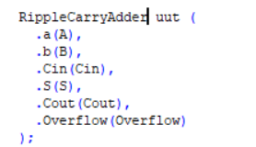
Results
Ripple Carry Adder
Changes in Test Bench

Slide 15
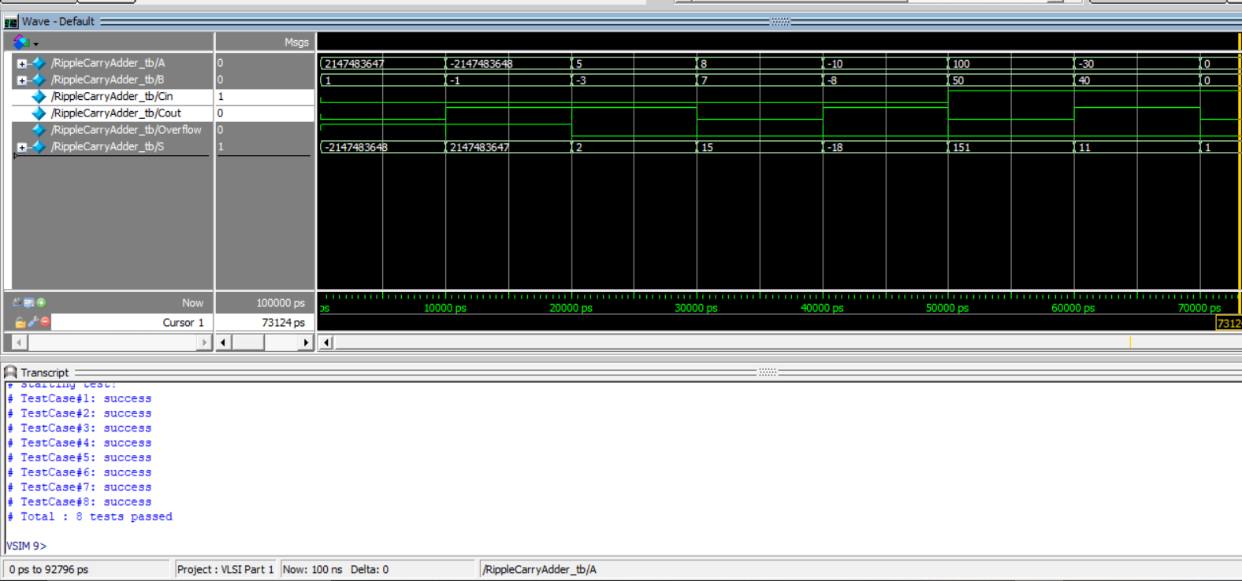
Results
Ripple Carry Adder

Slide 16
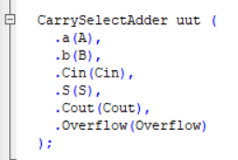
Results
Carry Select Adder
Changes in Test Bench

Slide 17
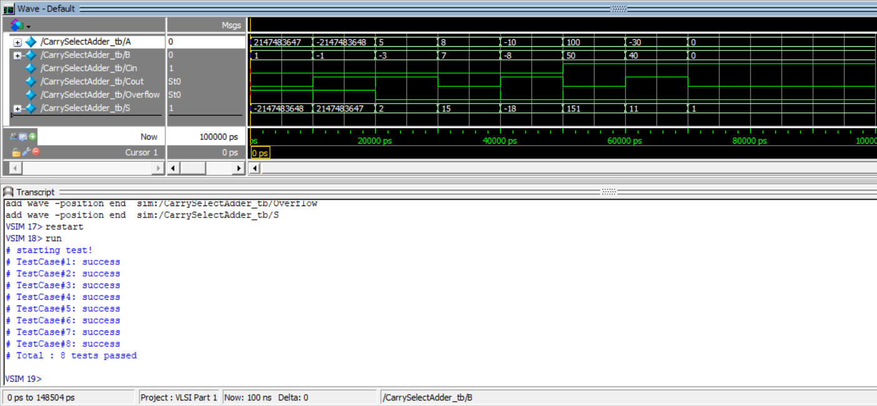
Results
Carry Select Adder

Slide 18
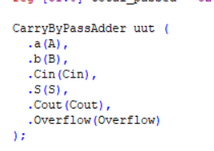
Results
Carry Bypass
Changes in Testbench

Slide 19
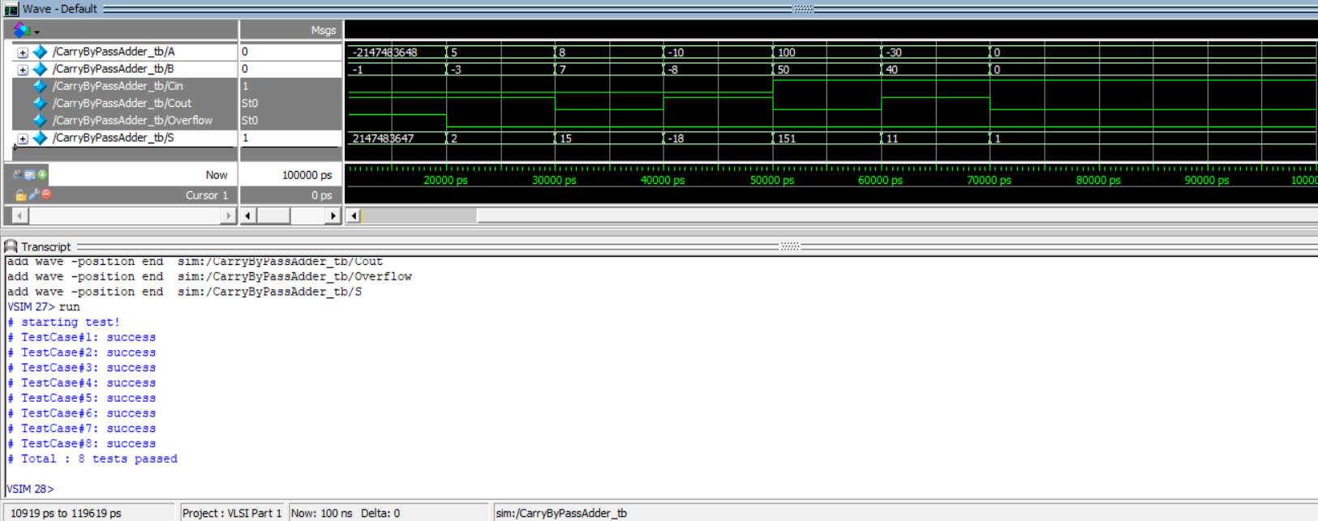
Results
Carry Bypass

Slide 20
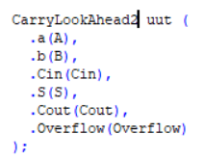
Results
Carry Look ahead
Changes in Test Bench

Slide 21
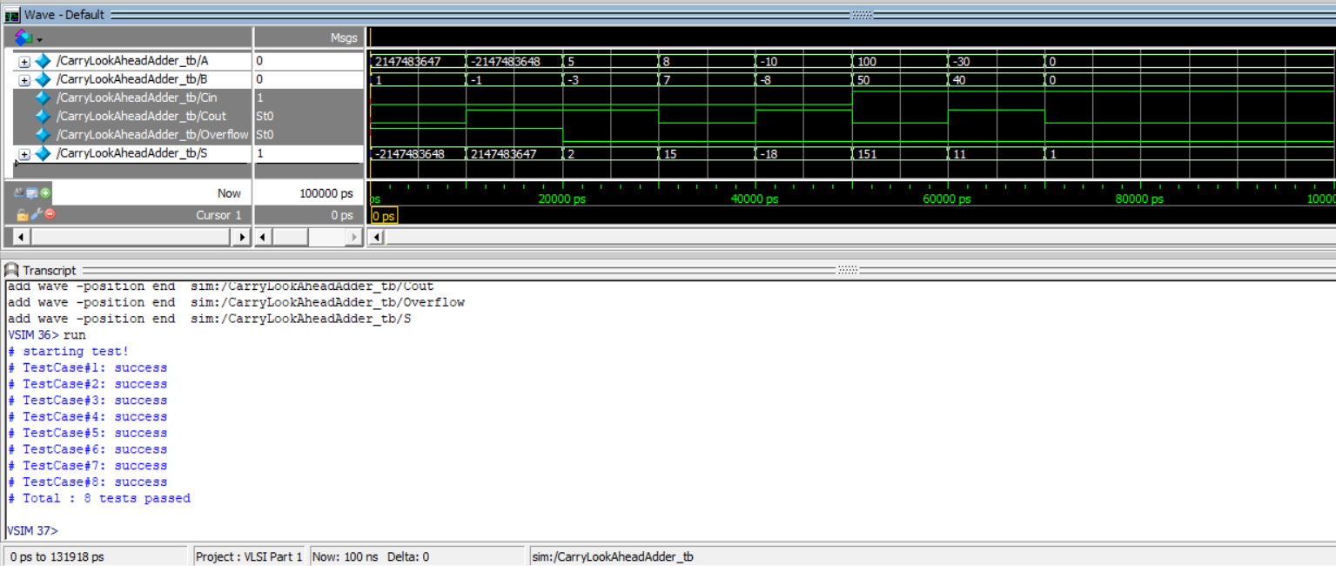
Results
Carry Look ahead

Slide 22
Synthesis Results
Adder Type Properties | Verilog ‘+’ | Carry Bypass | Carry Select | Carry Lookahead | Ripple Carry
Max Delay | 12.26 ps | 11.57 ps | 8.24 ps | 4.6 ps | 14.19 ps
Min Delay | 1.69 ps | 1.63 ps | 1.67 ps | 1.68 ps | 1.67 ps
Total Power | 403.8777 uW | 518.7082 uW | 980.5375 uW | 790.9255 uW | 629.3212 uW
Area | 976.895985 | 1360.281605 | 2123.366425 | 2611.814410 | 1301.299213
Number of Combinational Cells | 35 | 99 | 164 | 280 | 99

Slide 23
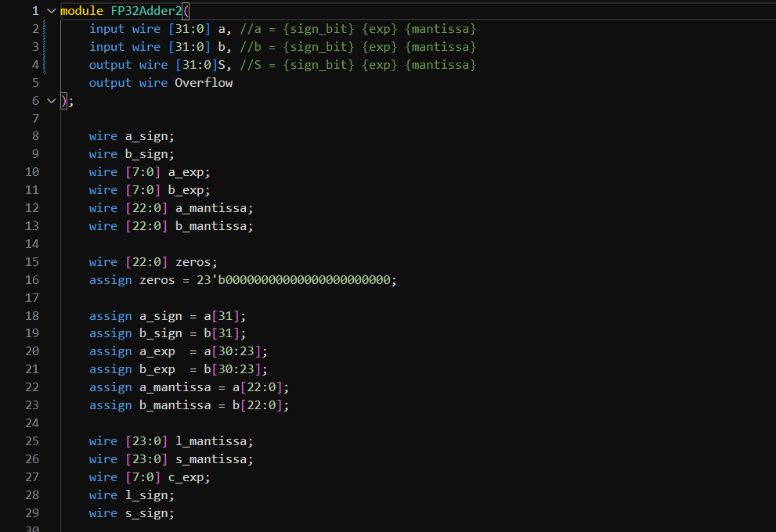
Floating Point Adder
We chose The Time Design Metric to implement this adder, so we chose Carry Lookahead adder.
Code:

Slide 24
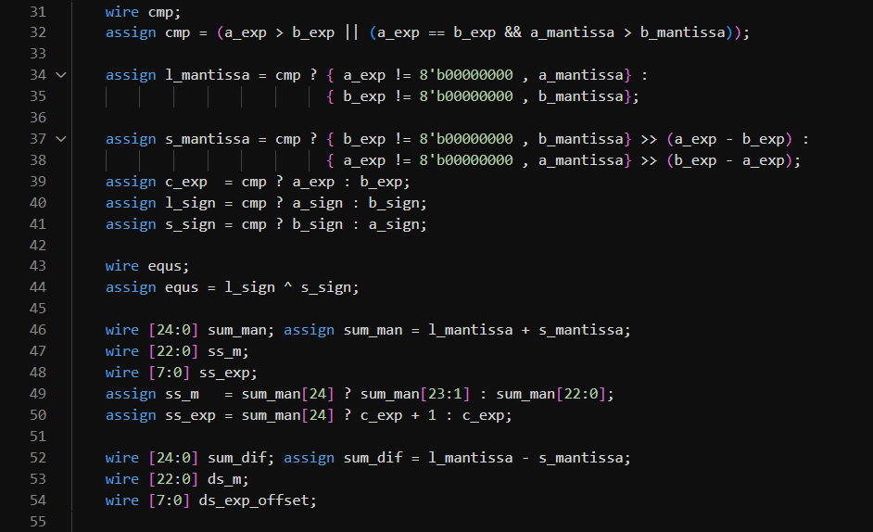
Floating Point
Continue Code:

Slide 25
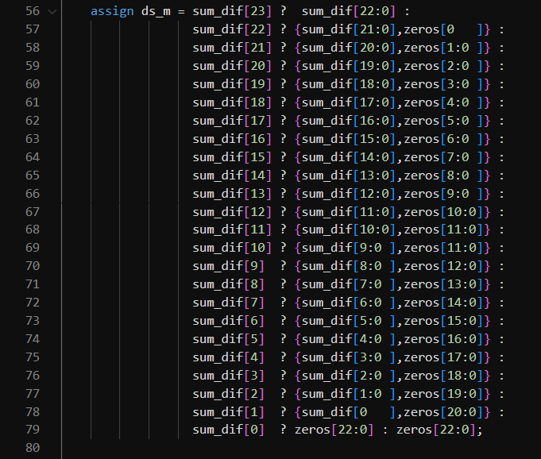
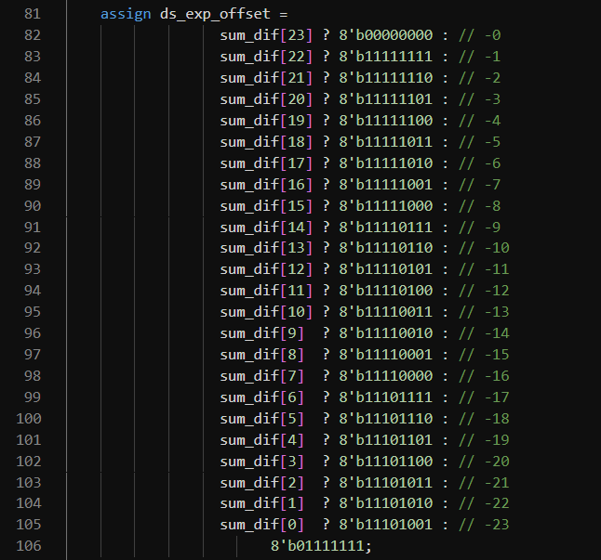
Floating Point

Slide 26
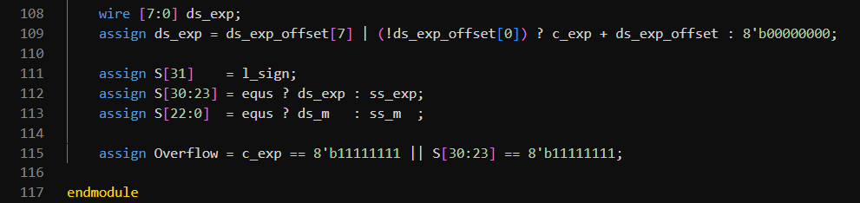
Floating Point
End

Slide 27
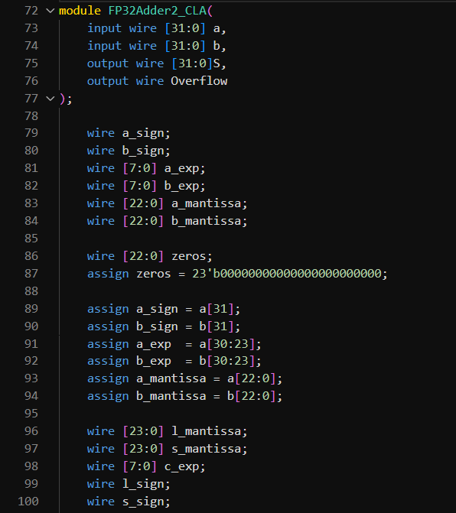
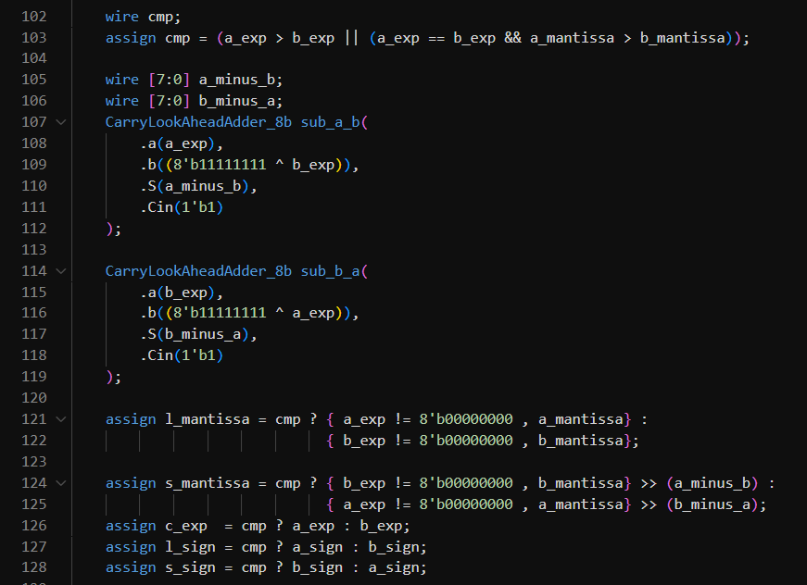

Slide 28
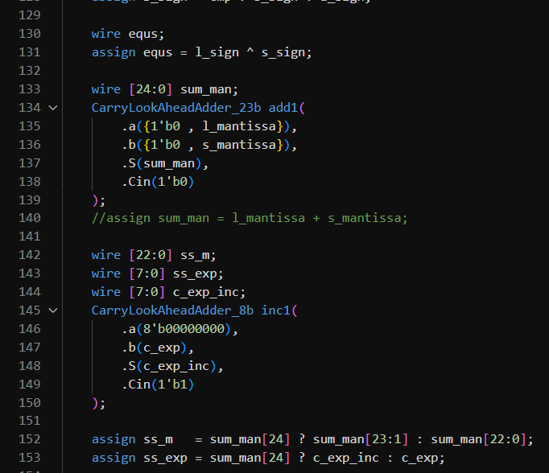
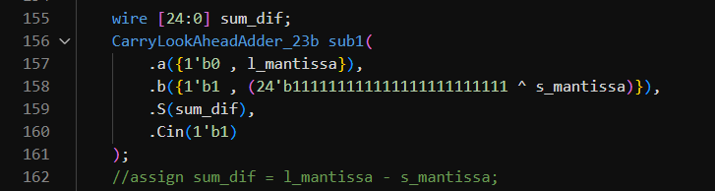

Slide 29
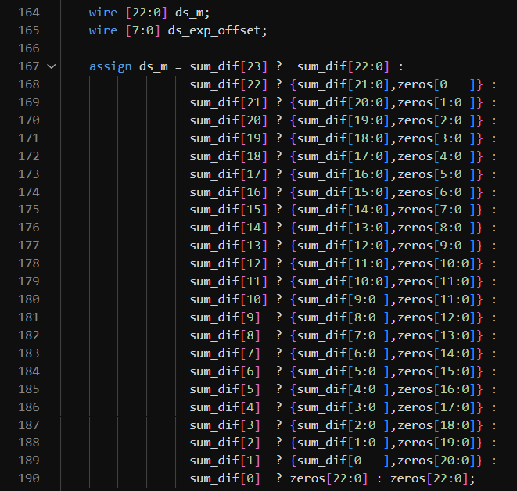
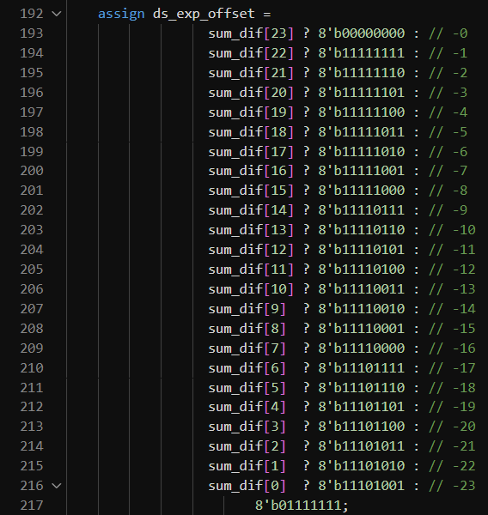

Slide 30
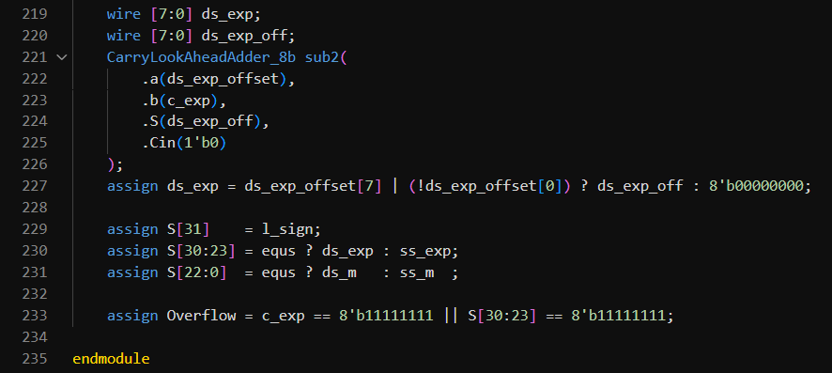

Slide 31
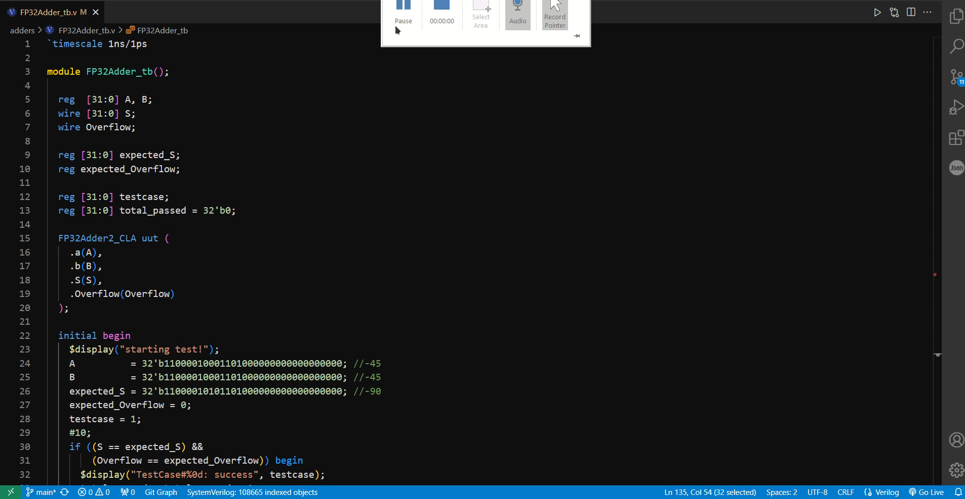
Floating Point Test bench

Slide 32
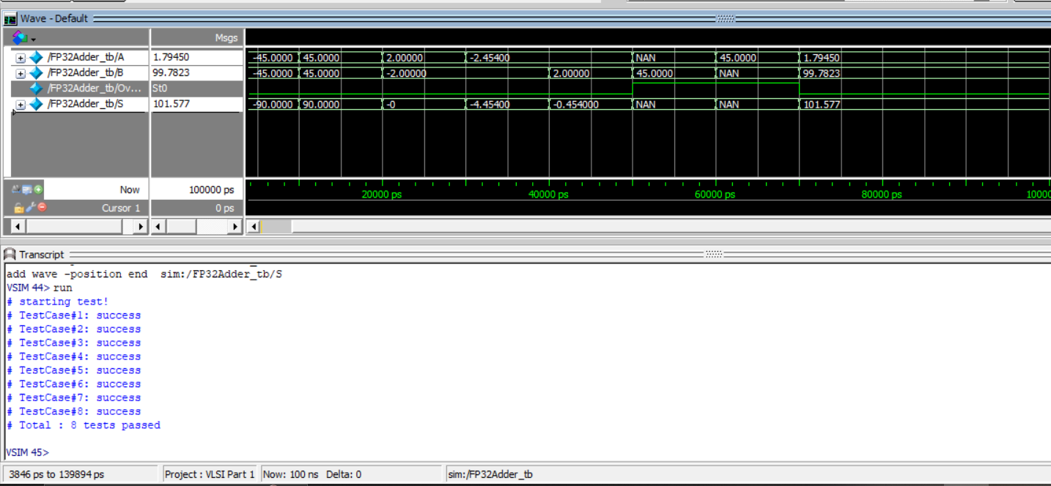
Floating Point Test bench (CLA)

Slide 33
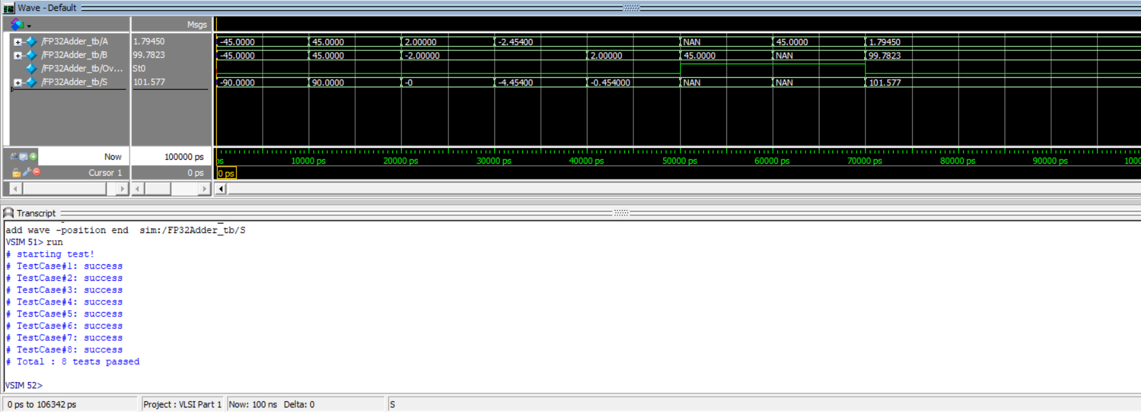
Floating Point Test bench (Verilog)

Slide 34
Floating Point Synthesis Result
Adder Type Properties | Floating Point Adder (CLA) | Floating Point Adder (Verilog)
Max Delay | 13.59 ps | 19.04 ps
Min Delay | 6.38 ps | 6.38 ps
Total Power | 2.8615e+03 uW | 2.2761e+03 uW
Area | 12624.421156 | 9840.718056
Number Combinational Cells | 1163 | 790

Slide 35
Synths code test bench

Slide 36
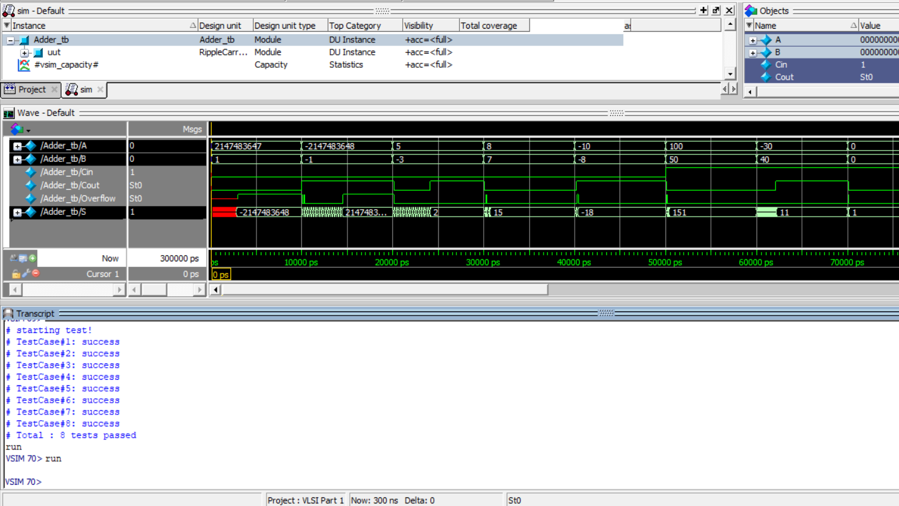

Slide 37
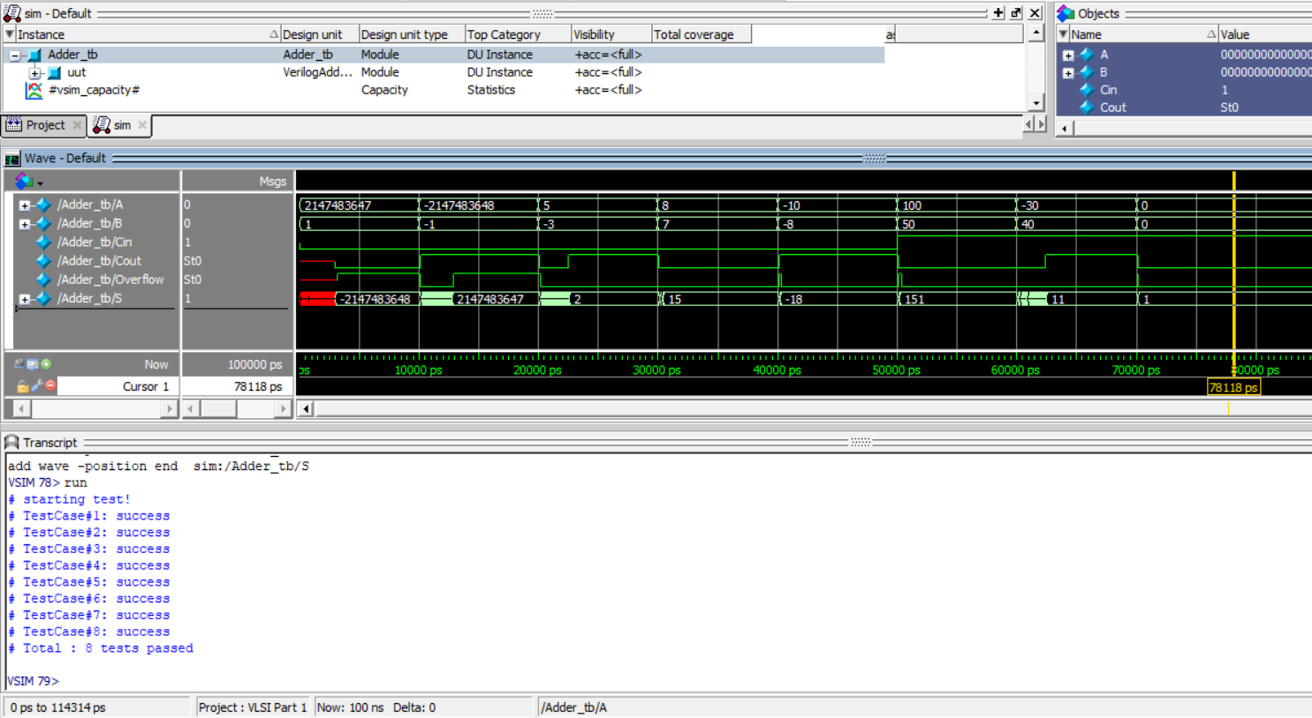

Slide 38
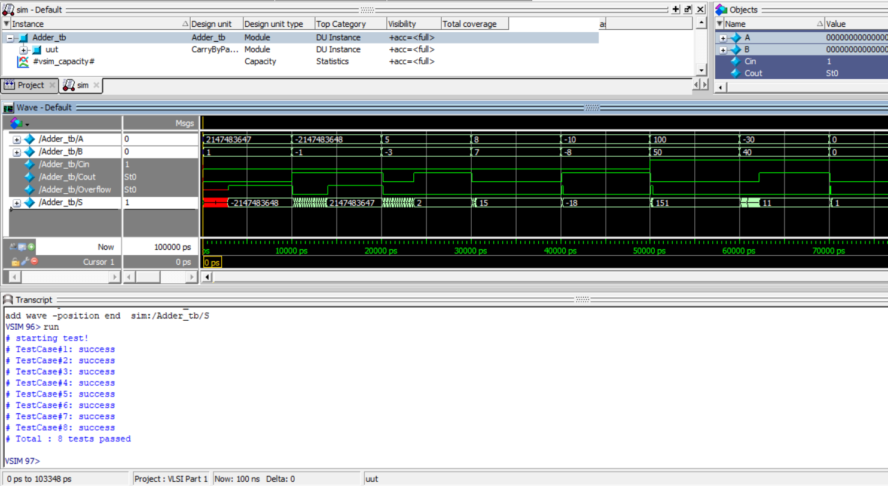

Slide 39
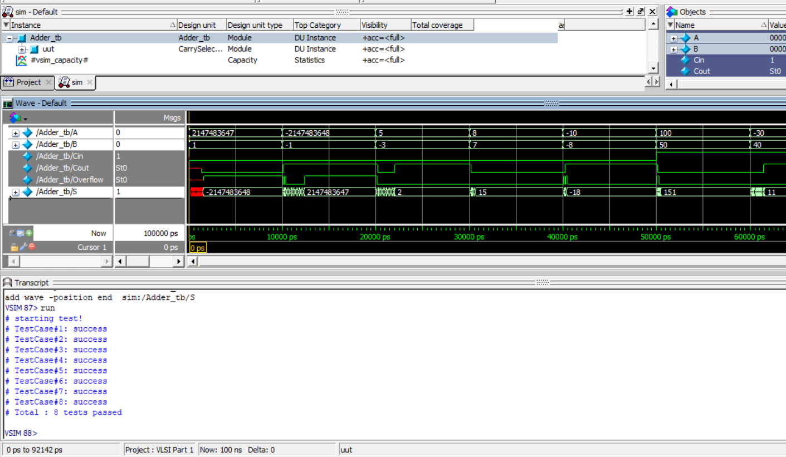

Slide 40
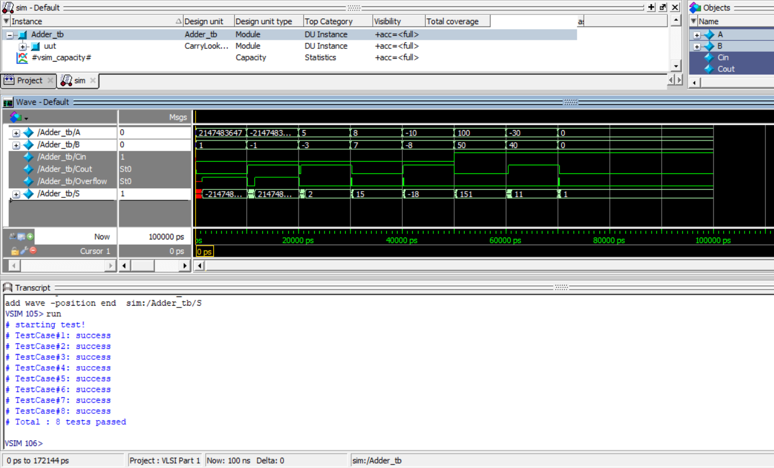

Slide 41
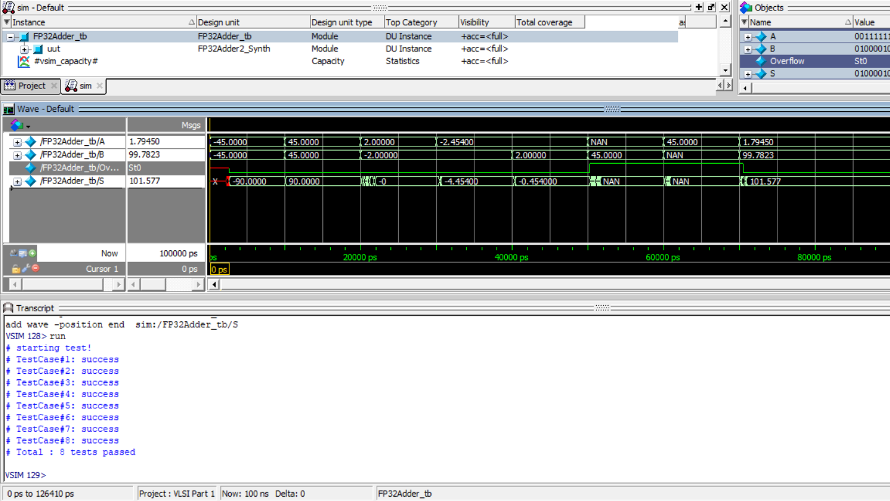

Slide 42
